Slide 1
CHLOE & STEVE’S WEDDING
MAY 18TH, 2026
36 GUESTS
CHÂTEAU DE NAINVILLE
WEDDING MOOD BOARD

Slide 2
SIGNS
Audrey’s note: To create an harmony between the differents signage I recommend using the same font style and color (as much as possible) – TBC with Chloe a design proof will be sent.

Slide 3
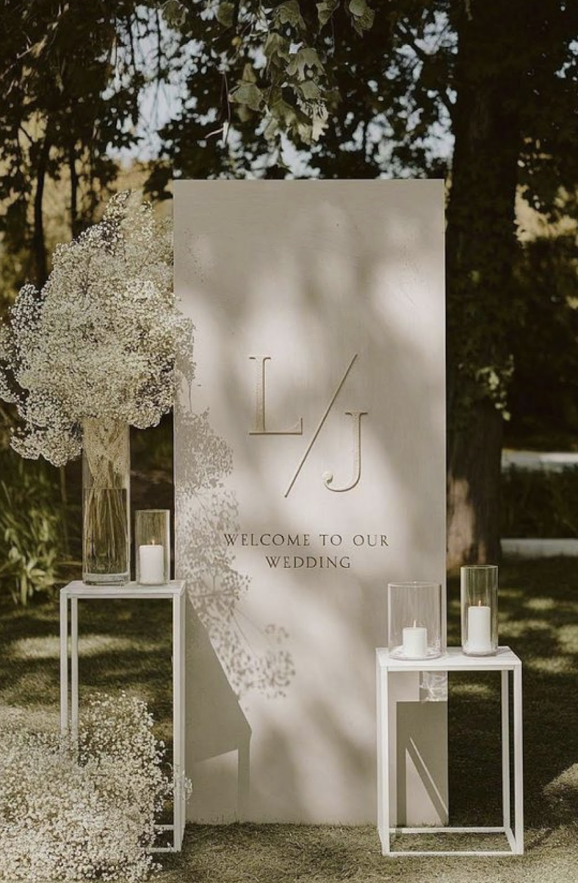
Welcome Sign & Décor
A warm white–toned welcome sign, with typography and detailing drawn from the reference image, will be beautifully complemented by two white wild spring floral arrangements in medium crystal vases and medium votive candles, creating a refined, sophisticated, and inviting entrance

Slide 4
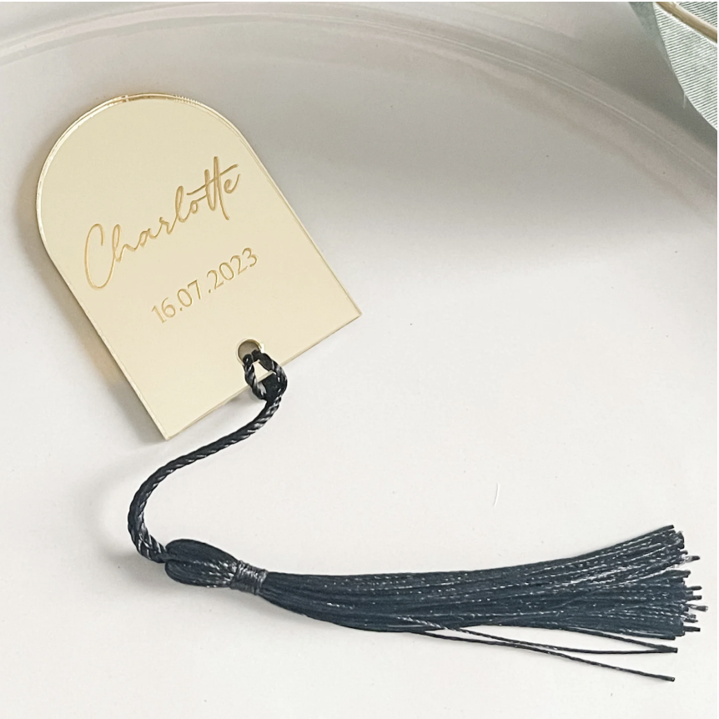
Place Cards
Audrey’s Note:
Please note that place cards are required by the catering staff regardless of round or rectangular tables. For weddings with more than 100 guests, place cards must be placed on each table with assigned seating, showing each guest’s full name, table number, and a meal icon/allergy note to guide the staff.

Slide 5
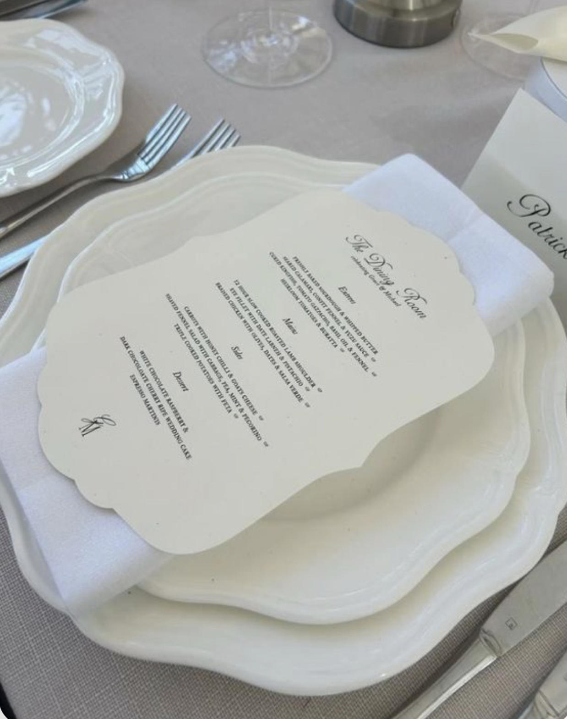

Menus
A large, stylish rectangular design, crafted from warm white, smooth, thick matte paper and adorned with elegant dark script typography, exudes sophistication and harmonious elegance
Audrey’s note to designer: Use Butterfly logo below at the bottom of the menu

Slide 6
NOTES POUR DESIGNER / IMPRIMEUR:
1 Welcome sign + 2 petites structure Blanche
36 Place cards
36 menus

